Slide 1
ECE423 Robotics and Automation
TITLE : K-Means Clustering-Based Kernel Canonical Correlation Analysis for Multimodal Emotion Recognition in Human-Robot Interaction
NAME : SOWMYA BARLA
ROLL NO : 2021BEC0027
1

Slide 2
Introduction:
The paper presents a novel multimodal emotion recognition system that enhances human-robot interaction (HRI) by improving emotion detection accuracy.
It focuses on using speech and facial expressions together to create a more accurate and robust emotion recognition model.
The method is built upon machine learning and signal processing techniques, utilizing K-Means Clustering and Kernel Canonical Correlation Analysis (KCCA) to improve the fusion of different data sources.
Unlike traditional unimodal methods, this approach ensures that complementary information is extracted from multiple modalities, leading to a more context-aware and adaptive emotion recognition system.
The methodology aims to address limitations of existing approaches, making emotion recognition more reliable and accurate for real-world applications.
2

Slide 3
Introduction:
Human-Robot Interaction (HRI) is the study of how humans and robots communicate and work together.
Feature Fusion: Combining Multiple Data Sources for Improved Recognition
Combining data from different sources (e.g., speech and facial expressions).
Merges the strengths of each data type for more accurate emotion recognition.
Speech tells us the tone of voice, while facial expressions show physical reactions, both contributing to a clearer emotional picture.
K-Means Clustering: Grouping Similar Data Points to Reduce Dimension
A technique that groups similar data points together into clusters.
Helps simplify data by grouping similar items, making it easier to analyze.
Grouping facial expressions that show similar emotions, like happy or sad, to recognize patterns.
3

Slide 4
Introduction:
Kernel Canonical Correlation Analysis (KCCA): A technique to find relationships between two different datasets using kernel methods.
A method to find connections between two datasets, even when the relationships are non-linear.
Allows us to link data from different sources (like speech and facial expressions) in complex ways.
Linking the tone of voice in speech with the movement of facial muscles to understand emotions better.
Multimodal Emotion Recognition: Identifying Emotions Using Multiple Data Types
Recognizing emotions by combining different data sources, like speech and facial expressions.
Provides a more complete picture of emotions, improving accuracy.
Example: Using both tone of voice and facial expressions to detect if someone is angry or happy.
4

Slide 5
Why was this paper Proposed?
Existing emotion recognition methods focus on single modalities (only speech or only facial expressions).
Single-modality methods are less accurate due to noise, occlusions, or missing features.
The paper proposes a better fusion approach to improve emotion recognition using both speech and facial expressions.
Need for Robust Emotion Recognition: Current systems struggle with inconsistencies in real-world data, requiring a more adaptable and scalable method.
5

Slide 6
Limitations of Previous Studies:
Single-Modality Weaknesses:
Speech-based methods fail in noisy environments.
Facial expressions can be affected by occlusions or lighting.
Basic Fusion Techniques:
Simple concatenation or PCA does not fully exploit the relationship between features.
No Proper Feature Selection:
Unnecessary features introduce noise, reducing accuracy.
Limited Generalization:
Existing methods often perform poorly on diverse datasets.
6

Slide 7
Proposed Method:
The main contributions include the following.
K-means clustering is introduced in fusion to strengthen the heterogeneity among emotions. It can extract features at the early fusion stage and remove the features with an adverse effect on recognition.
The in sufficient complementarity among different modalities is addressed for subsequent correlation analysis.
The kernel function is deployed to solve the nonlinear fusion problem.
The proposed multimodal fusion method can effectively improve the emotion recognition rate in HRI.
7

Slide 8
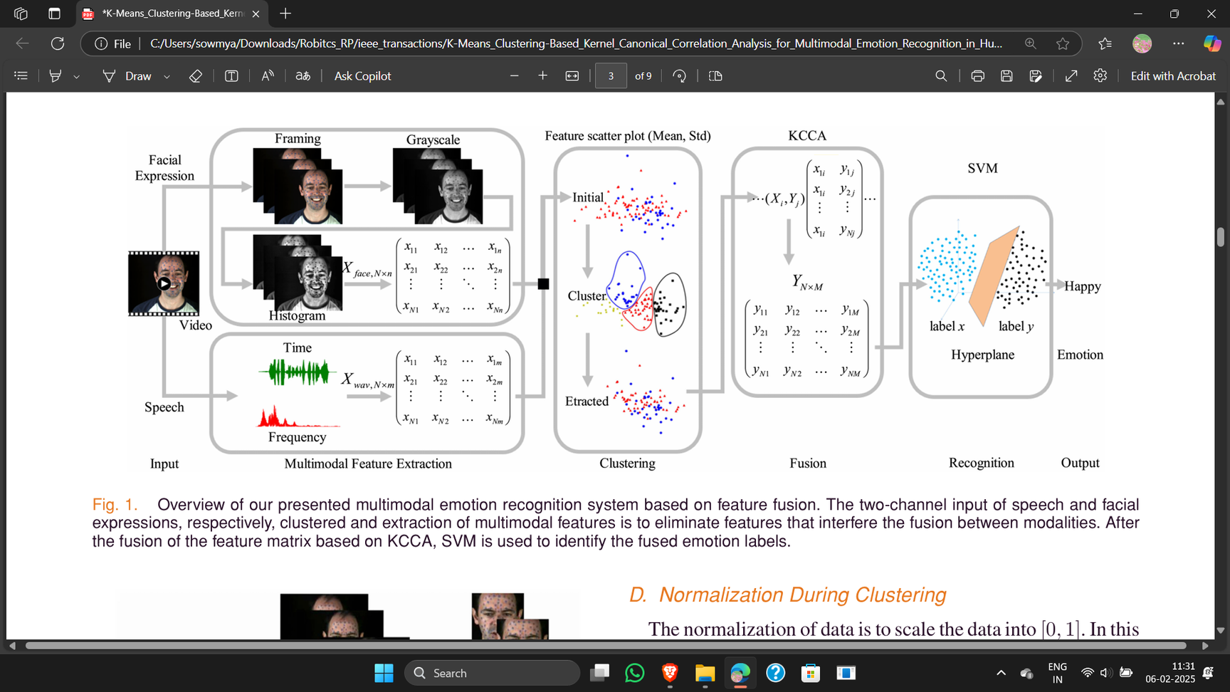
Block Diagram Explanation:
Data Input: Speech & Facial expressions.
Feature Extraction: Extract relevant features from each modality.
Feature Selection (K-Means): Remove unnecessary features.
Feature Fusion (KCCA): Combine features while preserving nonlinear relationships.
Classification (SVM): Predict the emotion based on the fused features.
8

Slide 9
K-MEANS KERNEL CANONICAL CORRELATION ANALYSIS:
A. Preprocessing
For the facial expressions, first of all, equal frame distance of each video is extracted, and the face region is intercepted. Endpoint detection is carried out for each speech and divided into equidistant frames, with blank frames deleted.
B. Feature of Facial Expressions
In pixel method, the feature dimensionality is high and affected by the pose.
Adaptive histogram equalization suitable for producing more details improves image contrast. Histogram shearing is considered in this article
9

Slide 10
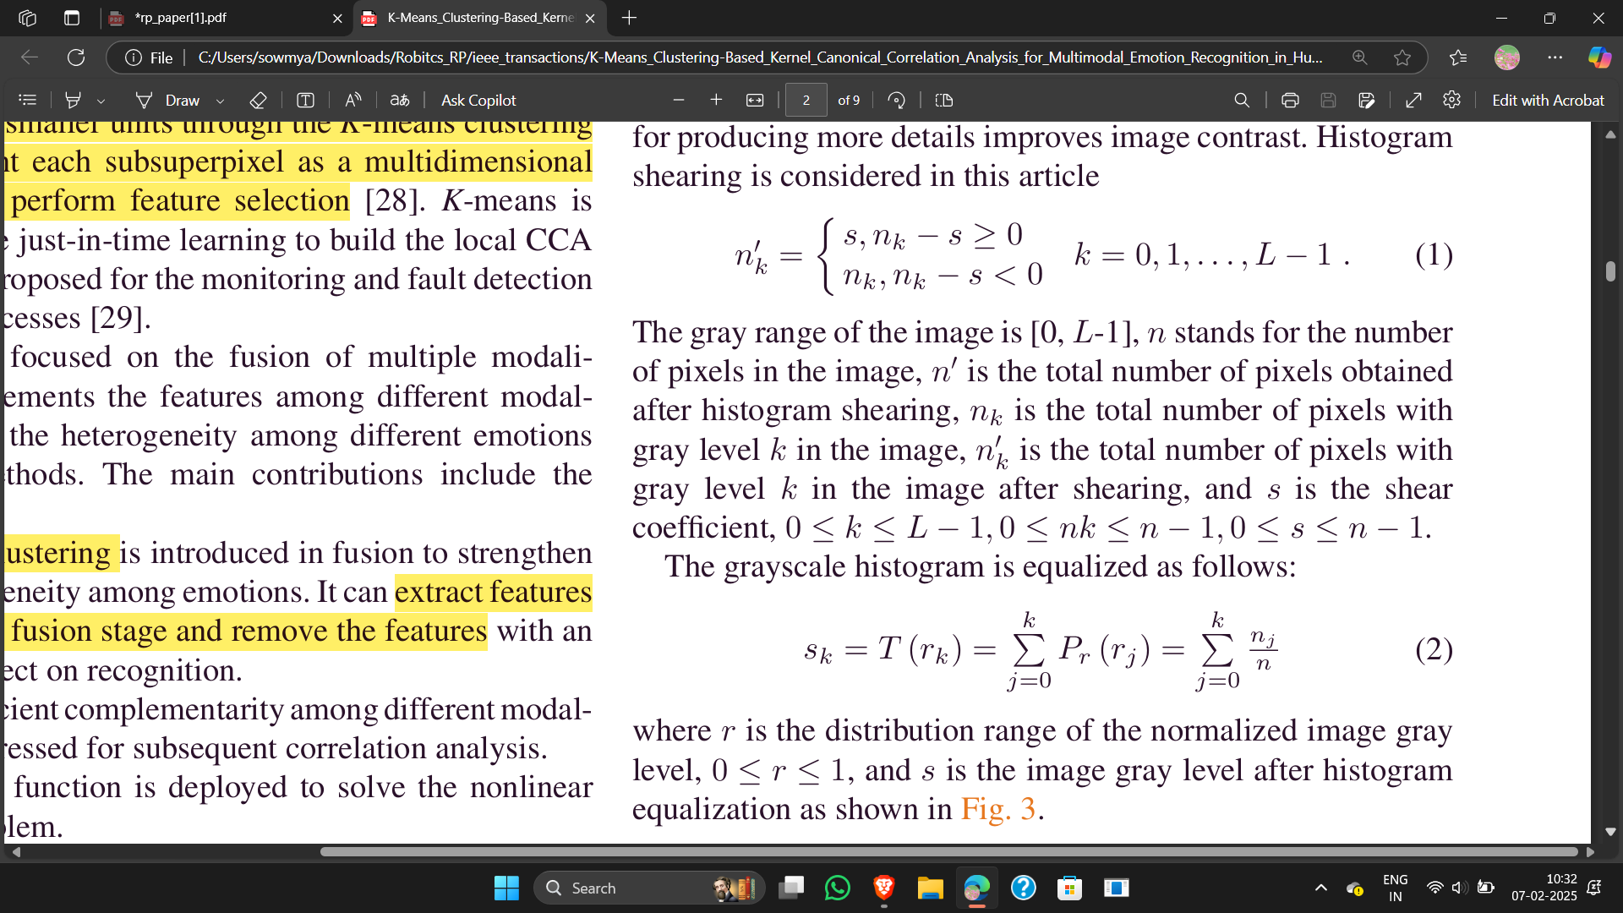
Histogram Shearing Equation:
nk​ → Number of pixels in the image that have gray level k(before shearing).
nk′→ Number of pixels in the image with gray level k after applying shearing (adjusted version of nkn​).
s → Shear coefficient (a threshold value to clip excessive intensities).
k → Gray level index, representing a particular intensity value in the grayscale range (from 0 to L−1).
L→ Total number of gray levels in the image (usually 256 for an 8-bit grayscale image).
If the number of pixels with intensity k exceeds s, it is clipped to s.
This prevents over-saturation of any intensity level, helping in better contrast adjustment.
10

Slide 11
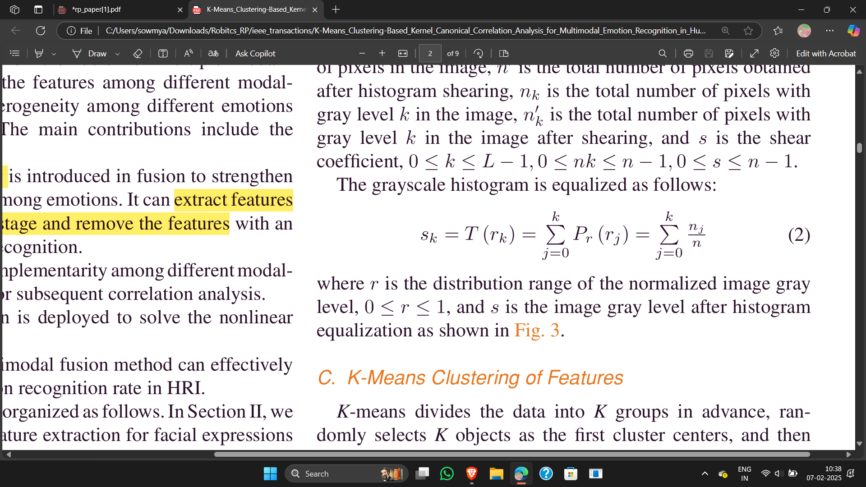
Histogram Equalization Equation:
sk​ → New intensity value after applying histogram equalization.
T(rk)→ Transformation function, which adjusts pixel intensity values.
rkr→ Original intensity value before equalization (ranges from 0 to L−1).
Pr(rj) → Probability distribution function (PDF) of intensity values, representing the fraction of pixels at each gray level j.
nj → Number of pixels with intensity j in the original image.
n → Total number of pixels in the image.
L → Total number of intensity levels (usually 256 in an 8-bit grayscale image).
This redistributes pixel intensities so that they are more evenly spread across all possible values.
The transformation function T(rk) maps original pixel values to new values based on their cumulative probability.
Enhances contrast, making darker regions brighter and lighter regions darker, improving the visibility of facial features.
11

Slide 12
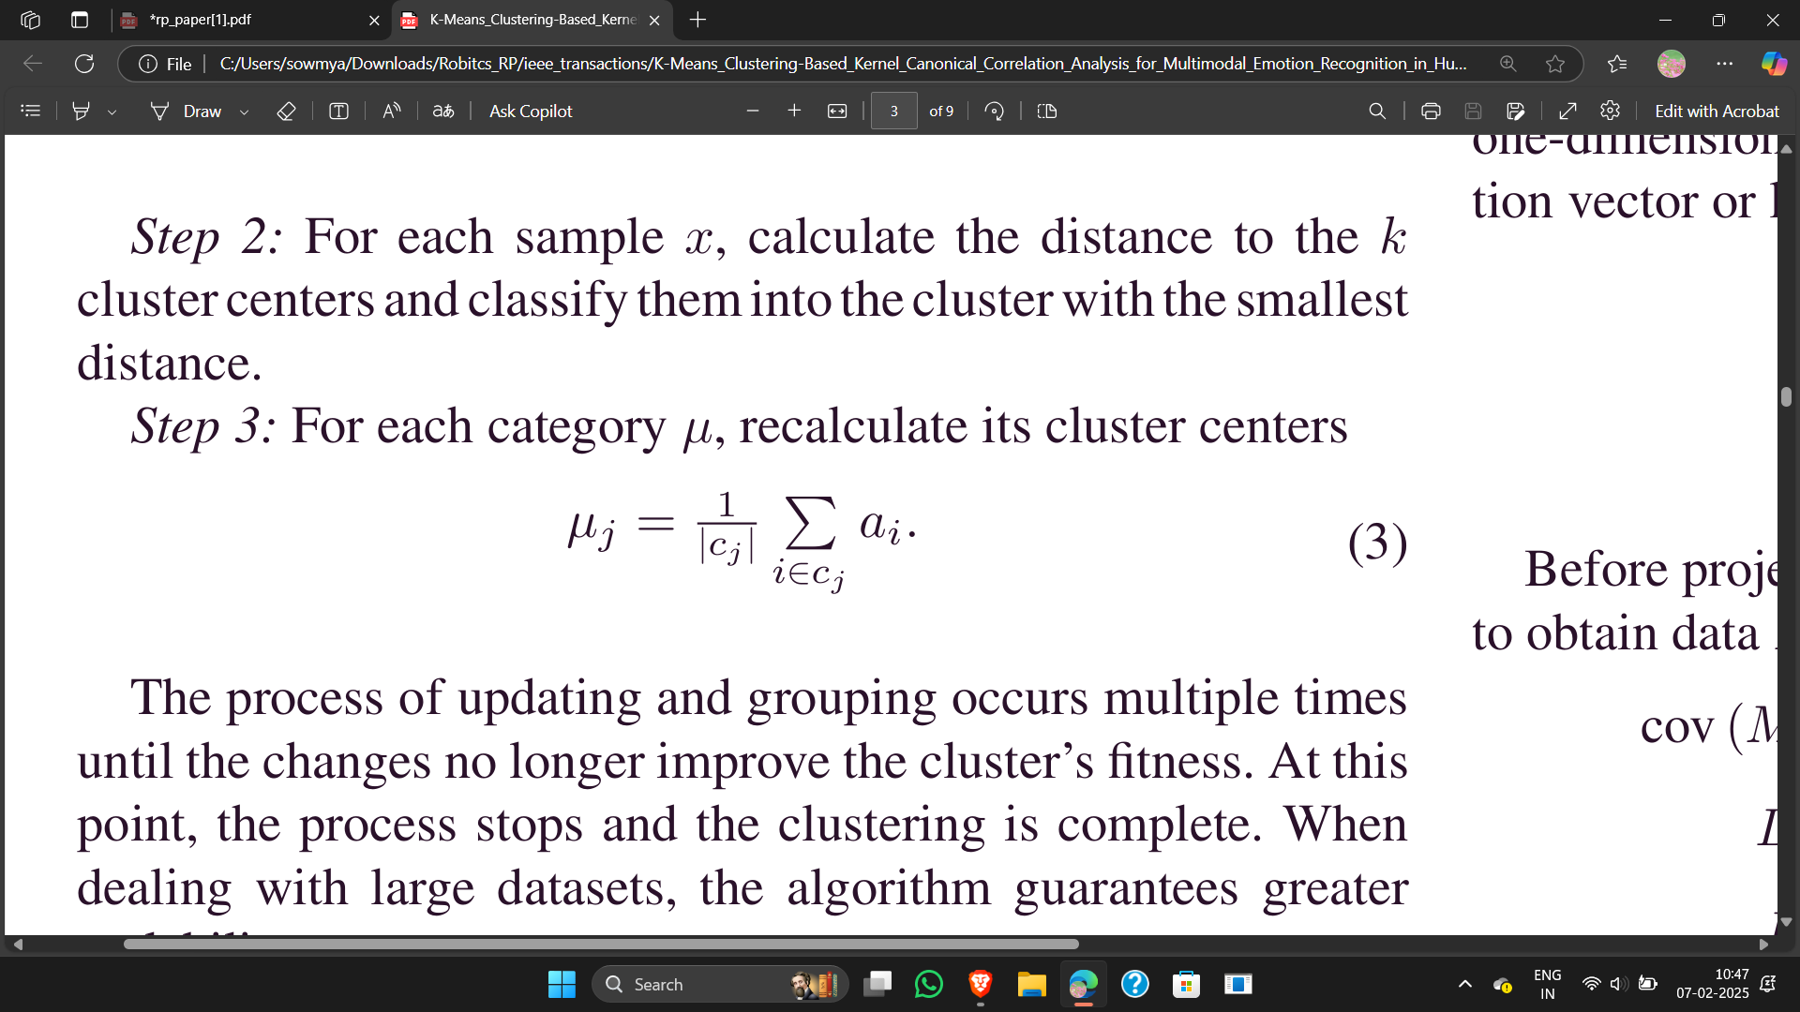
C. K-Means Clustering of Features:
Step 1: Select k initial samples as centers a1,a2,...,ak
Step 2: For each sample x, calculate the distance to the k cluster centers and classify them into the cluster with the smallest distance.
Step 3: For each category μ, recalculate its cluster centers
μj​ → New cluster center for cluster j.
Cj→ The set of all data points assigned to cluster j.
|Cj| → Total number of points in cluster j.
ai​ → Each individual data point in cluster j.
12

Slide 13
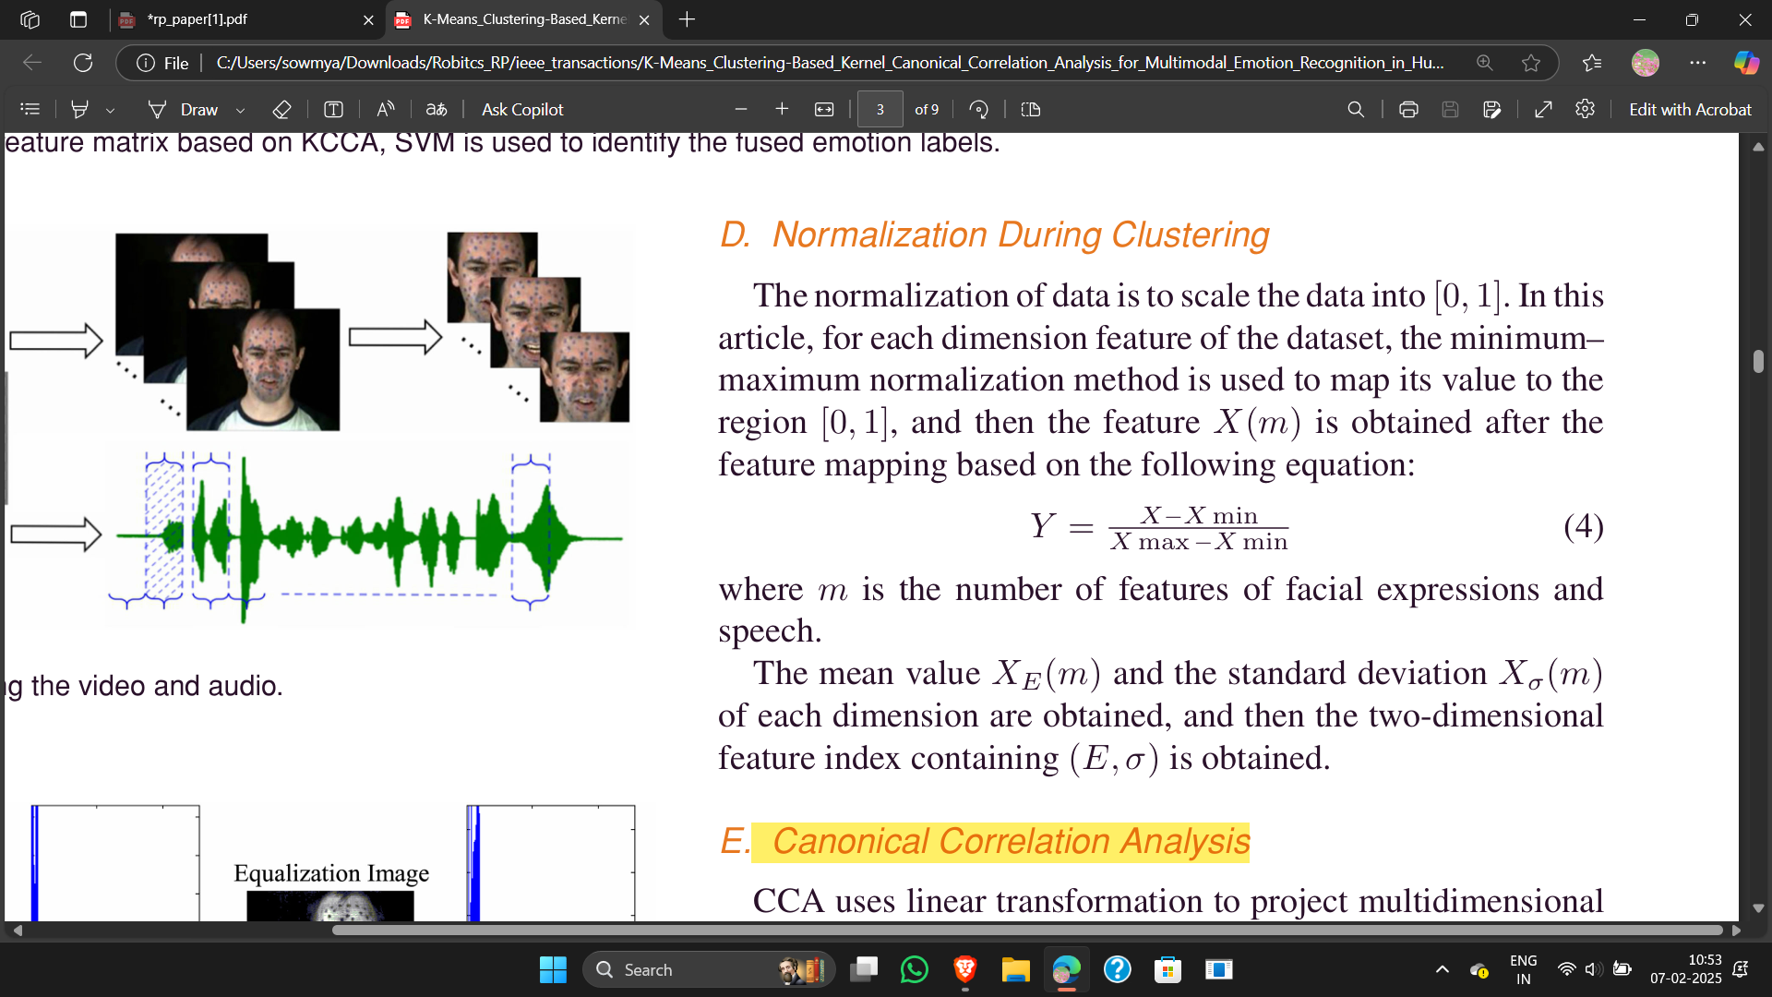
D. Normalization During Clustering:
Normalization ensures all features have the same range, preventing large values from dominating the clustering process.
Y → Normalized feature value (scaled between 0 and 1).
X → Original feature value.
Xmin​ → Minimum value of the feature in the dataset.
Xmax​ → Maximum value of the feature in the dataset.
13

Slide 14
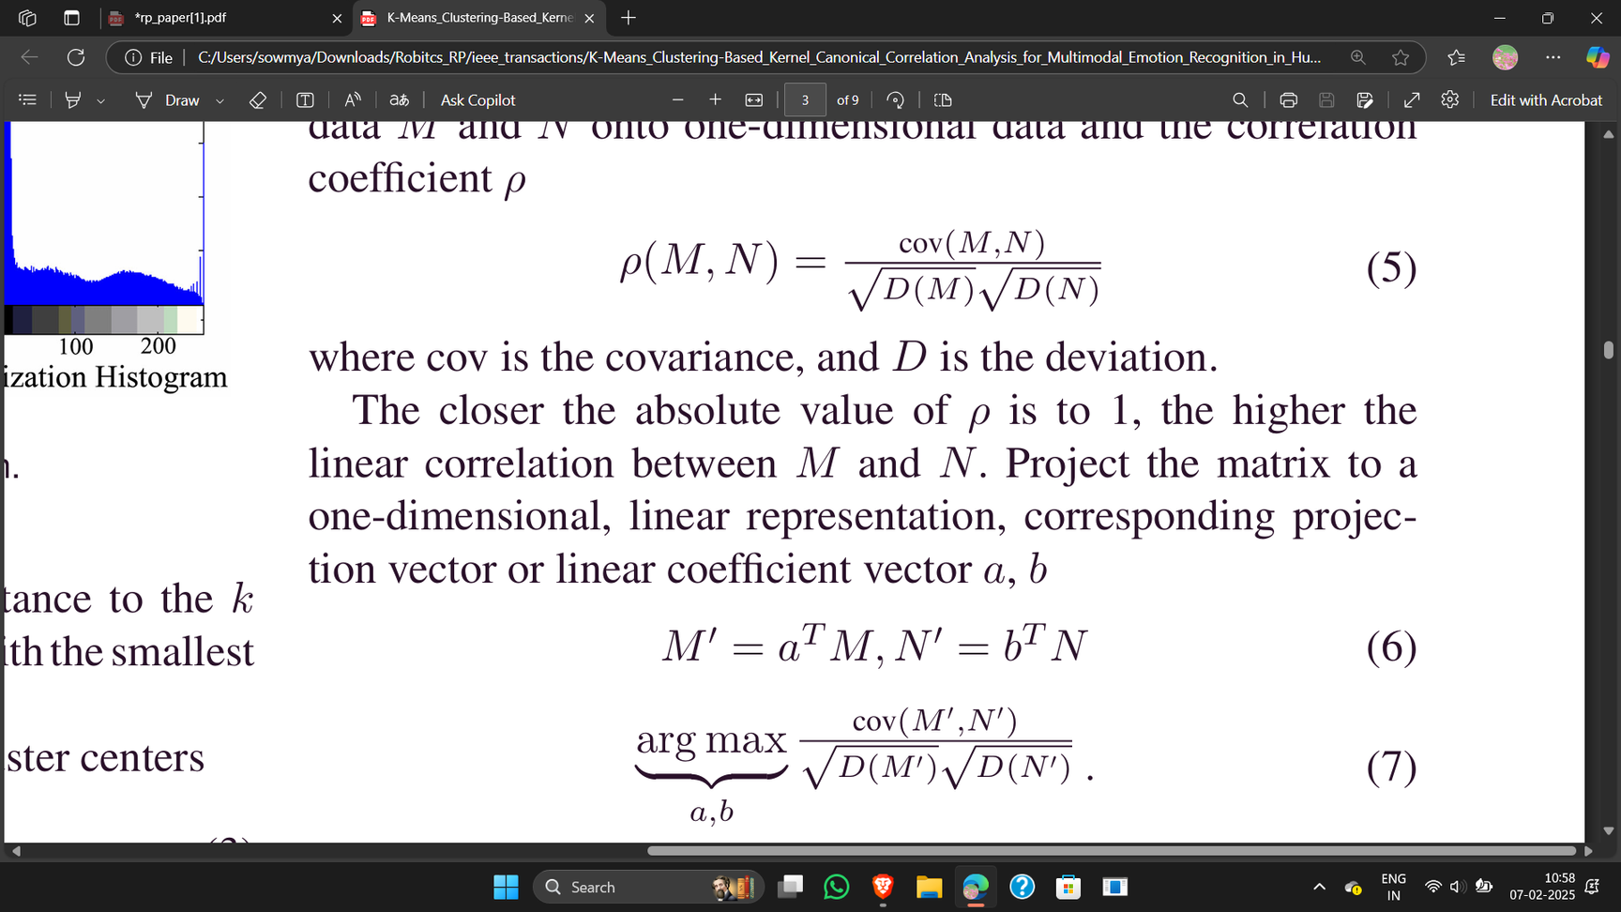
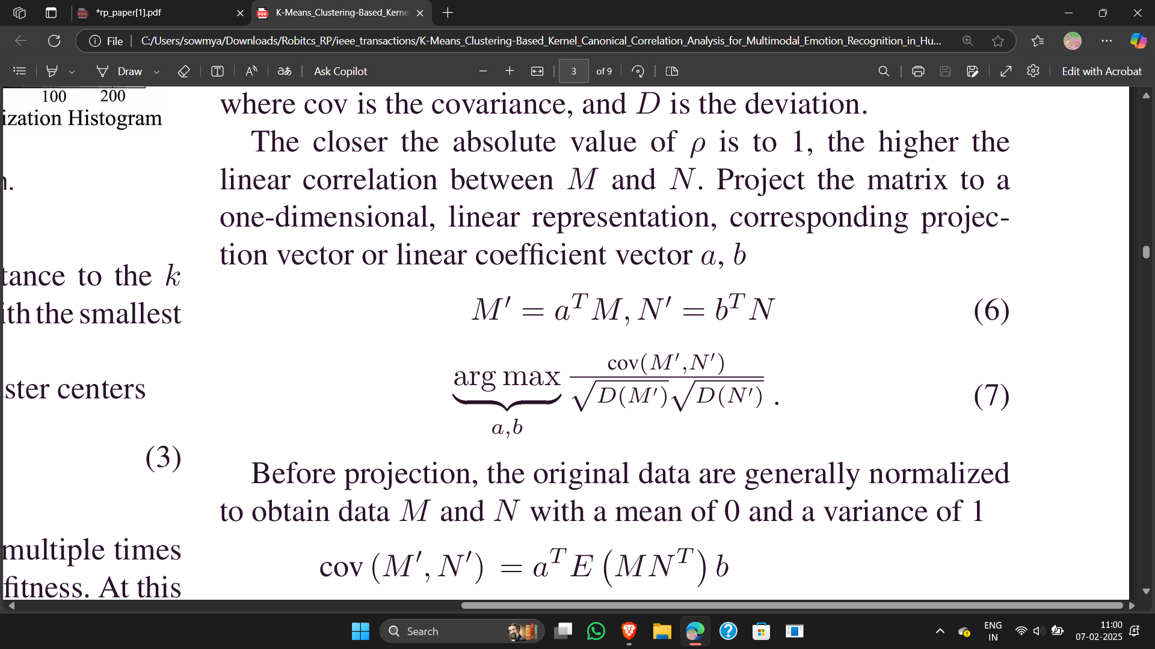
E. Canonical Correlation Analysis:
CCA projects the two feature sets (speech & facial expressions) into a new space where their correlation is maximized.
Correlation Formula:
ρ(M,N) → Correlation coefficient (higher means stronger relationship).
M, N → Feature sets of speech and facial expressions.
cov(M,N)→ Covariance (measures how much the two sets vary together).
D(M),D(N) → Variances of the feature sets.
Projection of Feature Matrices onto New Space:
a, b → Projection vectors that transform the features.
M’,N′ → Projected feature sets where correlation is maximized.
14

Slide 15
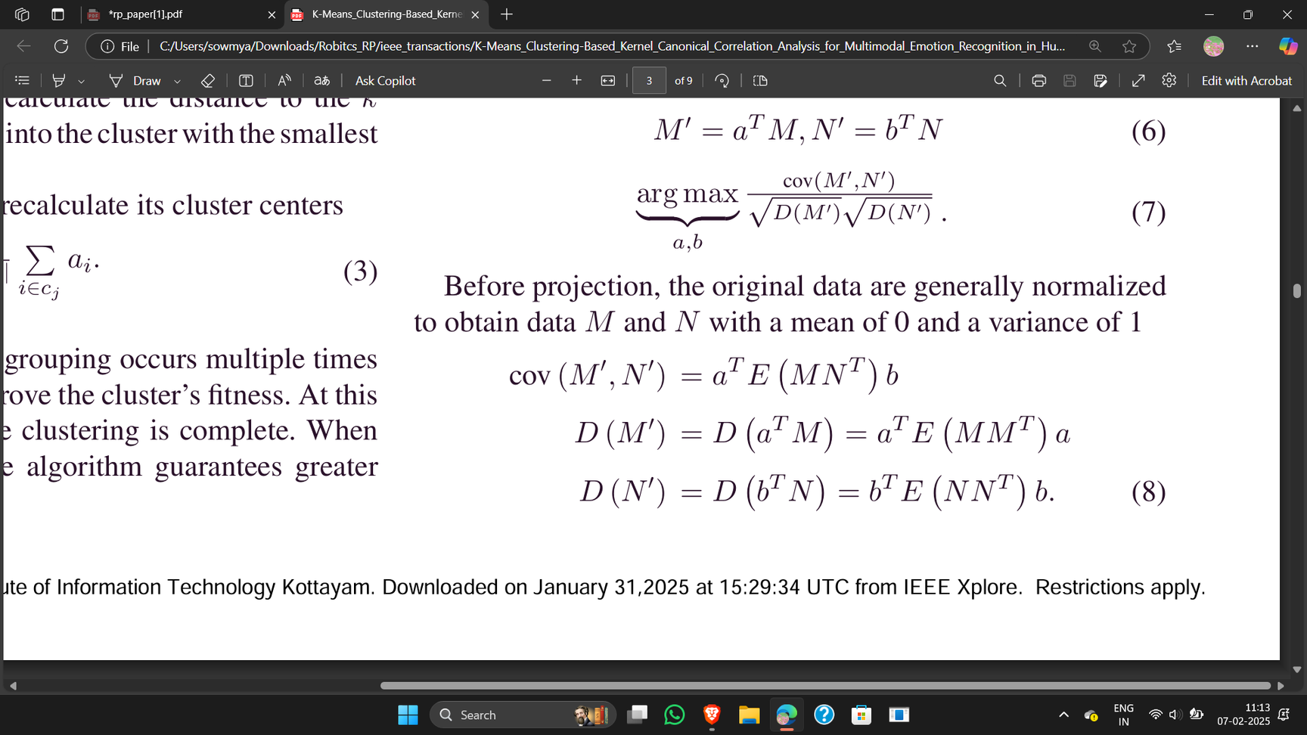
E. Canonical Correlation Analysis:
Optimization Problem for Maximum Correlation:
The goal is to find a and b that maximize the correlation between M′ and N′.
This ensures that the best possible projections are selected to maximize correlation between the modalities.
Normalization Before Projection:
E(MNT) → Expectation of the product of feature matrices.
E(M M^T), E(N N^T)→ Expectation of feature matrix self-products.
Meaning:
These equations standardize the data to ensure fair correlation computation.
15

Slide 16
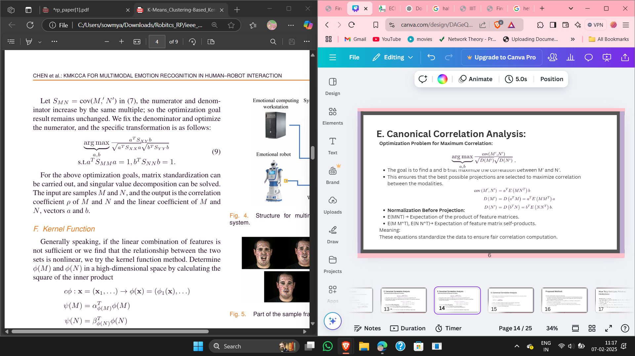
E. Canonical Correlation Analysis:
Final Optimization Equation Using Singular Value Decomposition:
SXY​ → Cross-covariance matrix between M and N.
SXX,SYY​ → Covariance matrices of and N.
M → Feature matrix of speech features (e.g., MFCCs, prosodic features).
N → Feature matrix of facial expression features (e.g., grayscale pixel intensities, shape features).
CCA finds the best correlation between two feature sets (speech & facial expressions).
This equation finds the best projection directions that maximize canonical correlation.
The constraint ensures that the projections remain valid unit vectors.
16

Slide 17
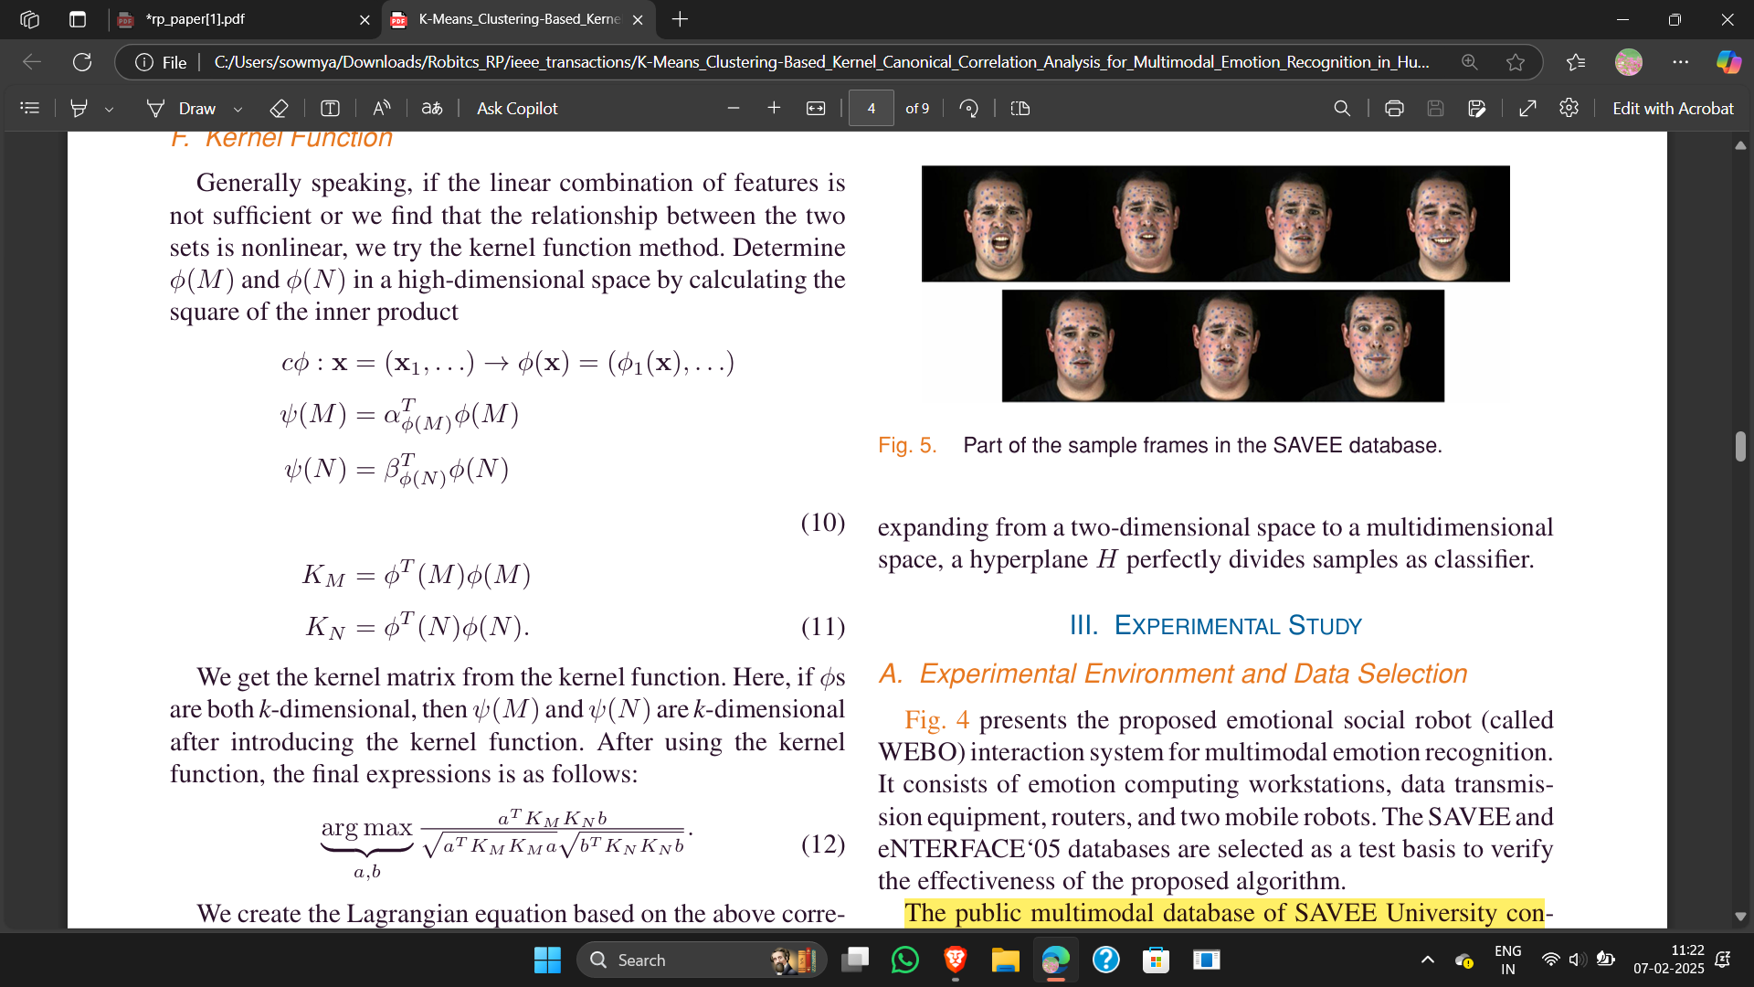
F. Kernel Function:
When speech and facial expression features have nonlinear relationships, simple linear methods like Canonical Correlation Analysis (CCA) fail to find meaningful patterns.
Kernel functions help by mapping the features into a higher-dimensional space, where their relationships become linear.
Kernel Transformation:
ϕ(M), ϕ(N)→ Nonlinear transformations of the original feature matrices M(speech) and NNN (facial expressions).
α, β→ Weight vectors for projecting transformed features.
KM​ and KN​ are kernel matrices, containing similarity measures between feature samples.
Final Kernel CCA Optimization Equation:
This equation finds the best projection vectors a and b to maximize the correlation between transformed feature sets.
17

Slide 18
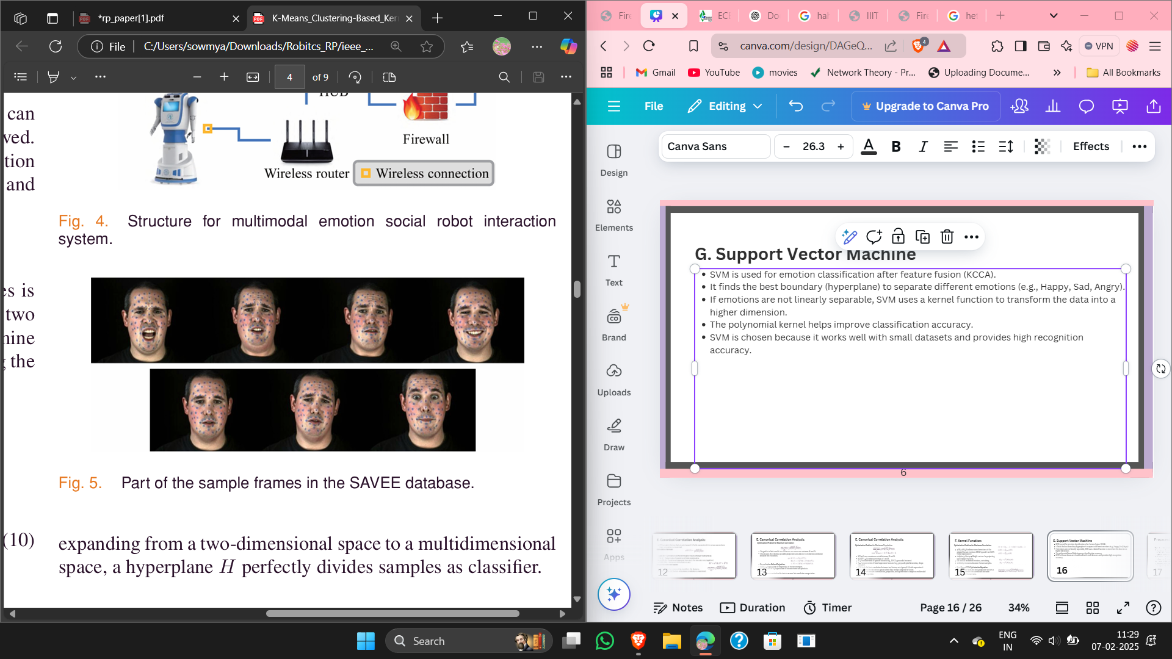
G. Support Vector Machine
SVM is used for emotion classification after feature fusion (KCCA).
It finds the best boundary (hyperplane) to separate different emotions (e.g., Happy, Sad, Angry).
If emotions are not linearly separable, SVM uses a kernel function to transform the data into a higher dimension.
The polynomial kernel helps improve classification accuracy.
SVM is chosen because it works well with small datasets and provides high recognition accuracy.
18

Slide 19
Experimental Environment and Data Selection
Setup & Datasets:
Tested on SAVEE and eNTERFACE‘05 datasets.
SAVEE has 480 samples (speech + facial expressions).
eNTERFACE‘05 has data from 44 people of different ethnicities
Feature Extraction:
Speech features: MFCCs, prosody, spectral features.
Facial features: Pixel grayscale values.
PCA was used to reduce dimensionality.
Key Findings:
Facial expressions had higher recognition rates in SAVEE (88.89%) than speech (59.72%).
Speech had better recognition rates in eNTERFACE‘05 (77.42%) than facial expressions (52.80%)
19

Slide 20
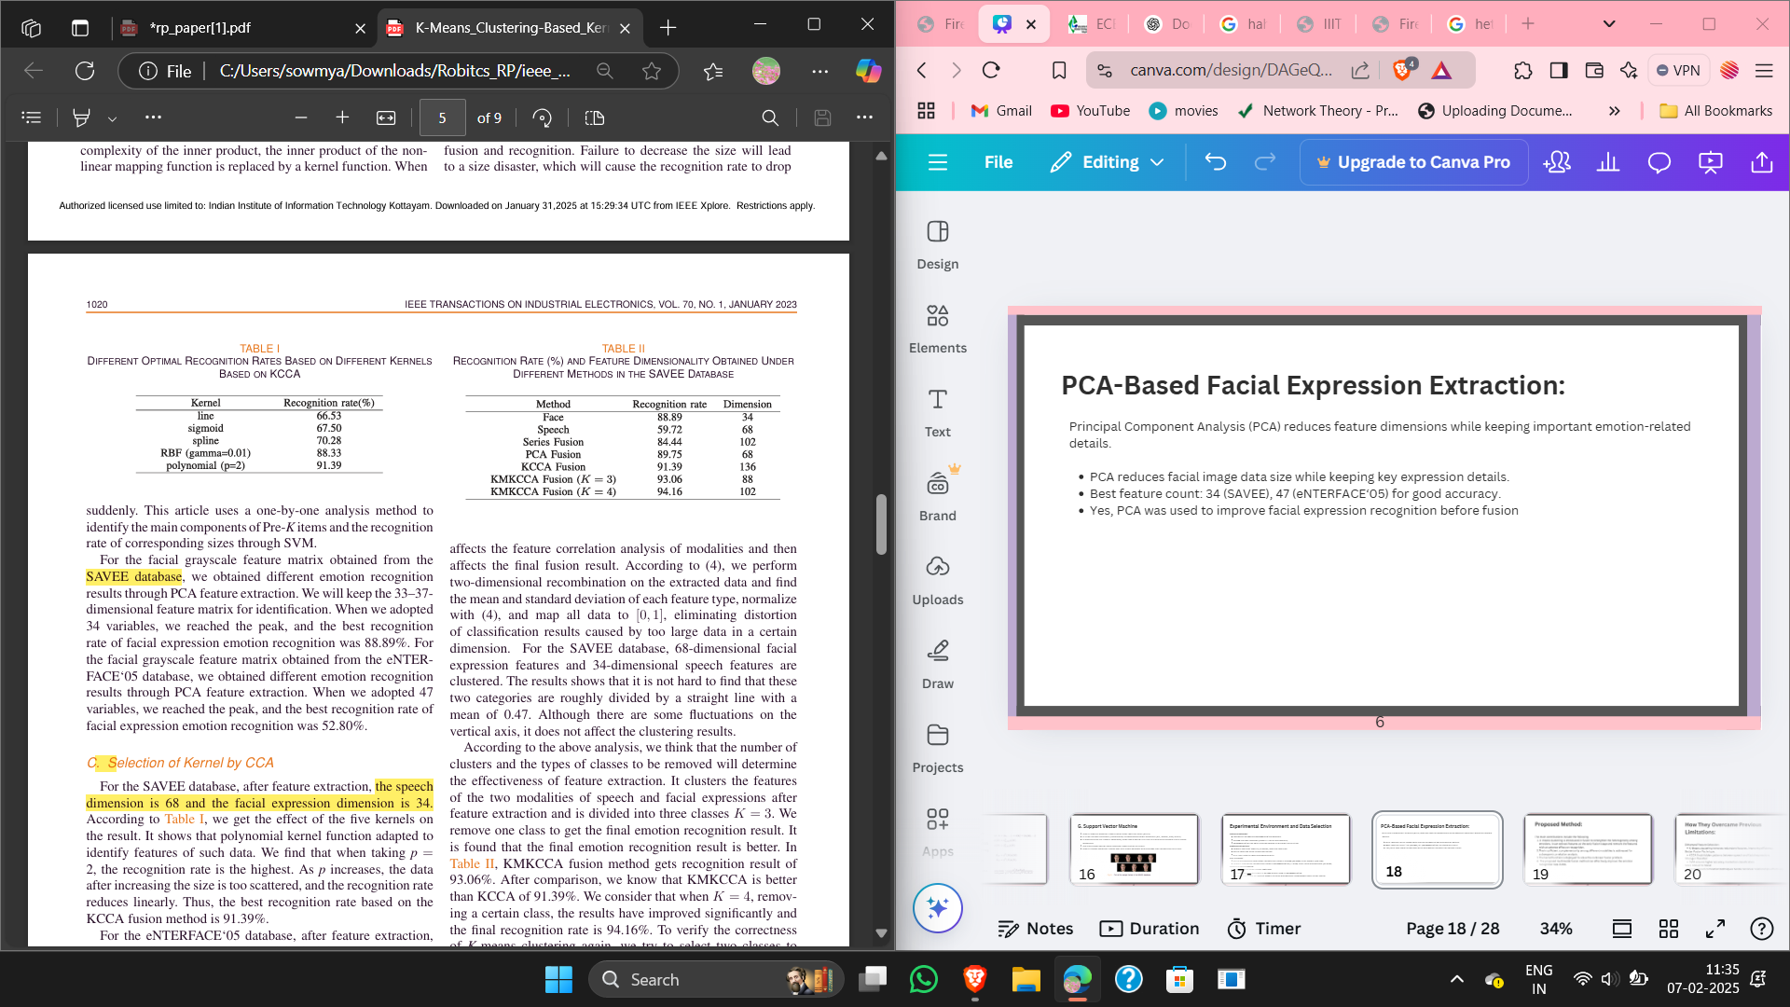
Selection of Kernel :
Polynomial Kernel (p = 2) gave the highest recognition rate for SAVEE (91.39%).
If p increases, data becomes too scattered, reducing accuracy.
For eNTERFACE‘05, Gaussian & low-order polynomial kernels worked better.
20

Slide 21
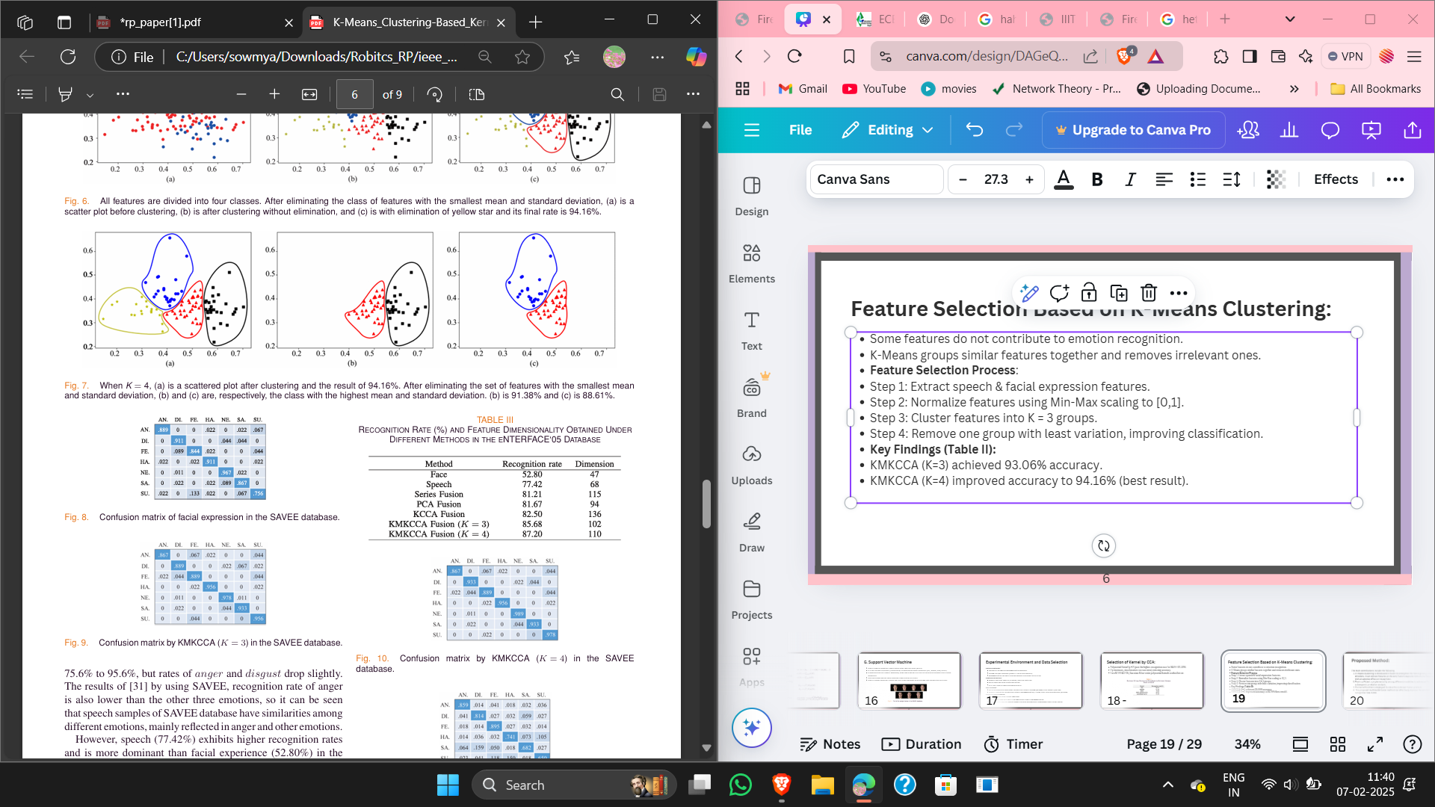
Feature Selection Based on K-Means Clustering:
Some features do not contribute to emotion recognition.
K-Means groups similar features together and removes irrelevant ones.
Feature Selection Process:
Step 1: Extract speech & facial expression features.
Step 2: Normalize features using Min-Max scaling to [0,1].
Step 3: Cluster features into K = 3 groups.
Step 4: Remove one group with least variation, improving classification.
Key Findings (Table II):
KMKCCA (K=3) achieved 93.06% accuracy.
KMKCCA (K=4) improved accuracy to 94.16%
(best result).
21

Slide 22
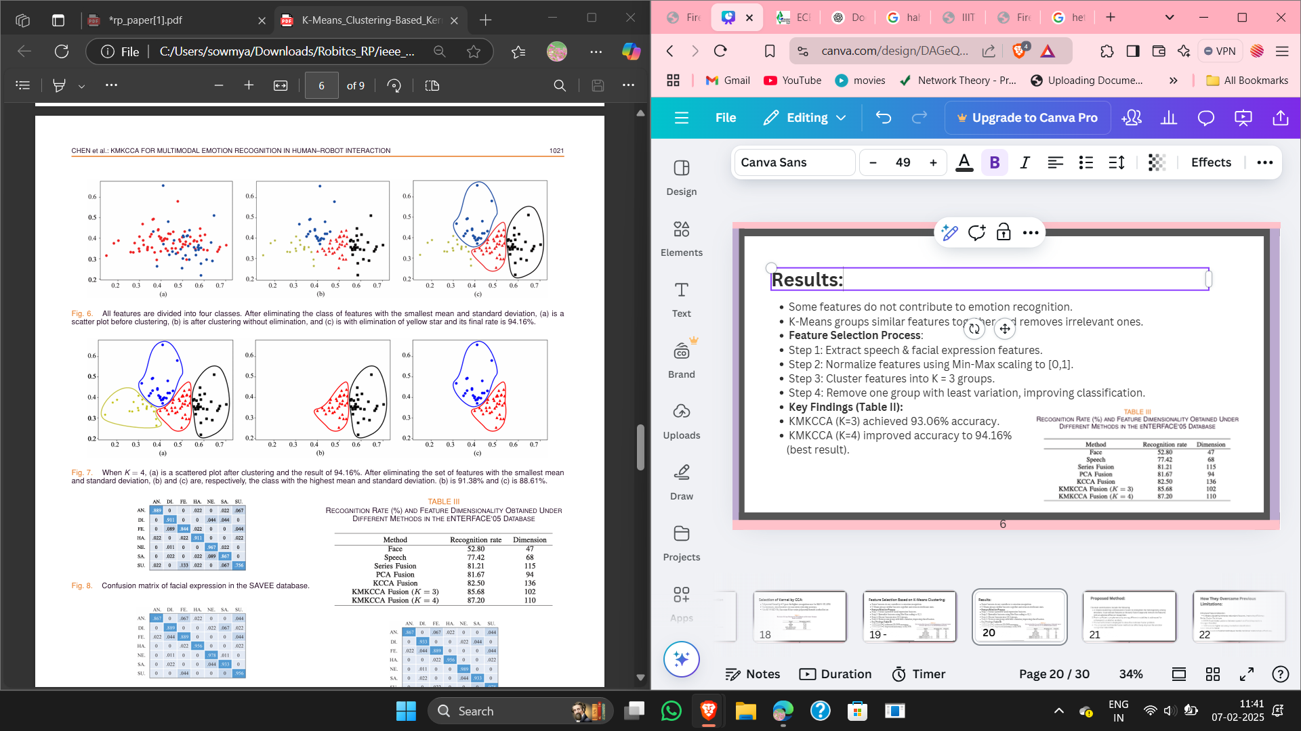
Feature Selection:
22

Slide 23
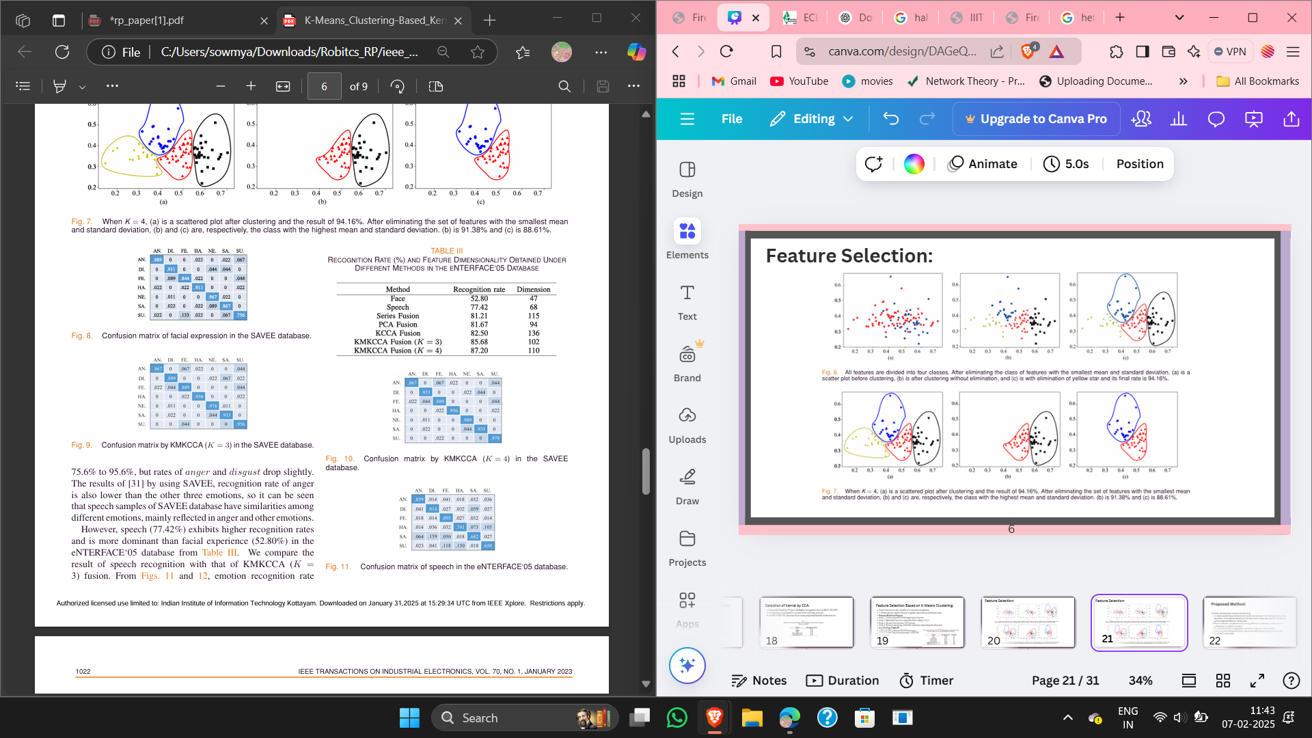
Results:
SAVEE Dataset (Figures 8–10)
K=3 Results (Fig. 9):
Surprise emotion recognition improved from 75.6% to 95.6%.
Anger & Disgust slightly decreased due to similarity in speech samples.
K=4 Results (Fig. 10):
Improved heterogeneity among emotions by removing weak features.
Higher overall accuracy (94.16%)​
23

Slide 24
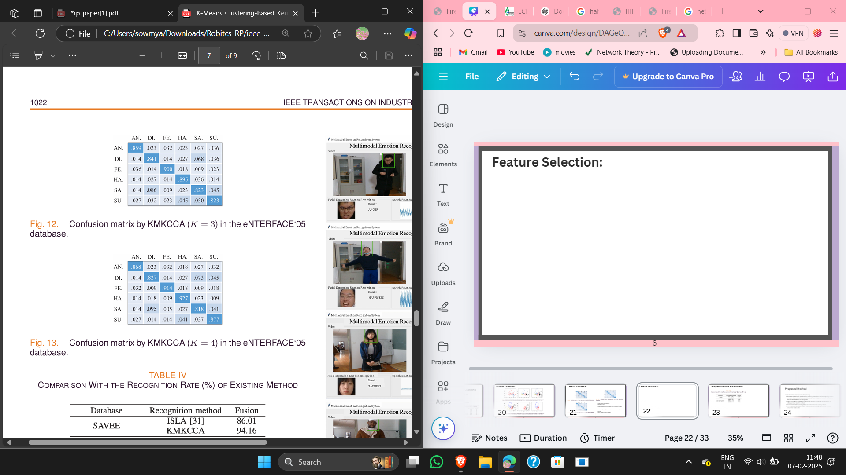
Results:
K=3 Results (Fig. 12):
Happiness increased from 74.1% to 89.5%.
Sadness improved from 68.2% to 82.3%, showing better modality complementarity.
K=4 Results (Fig. 13):
Further increased heterogeneity among emotions.
Higher accuracy overall due to better separation of emotions​
KMKCCA (K=4) consistently outperformed previous models, proving its effectiveness.
24

Slide 25
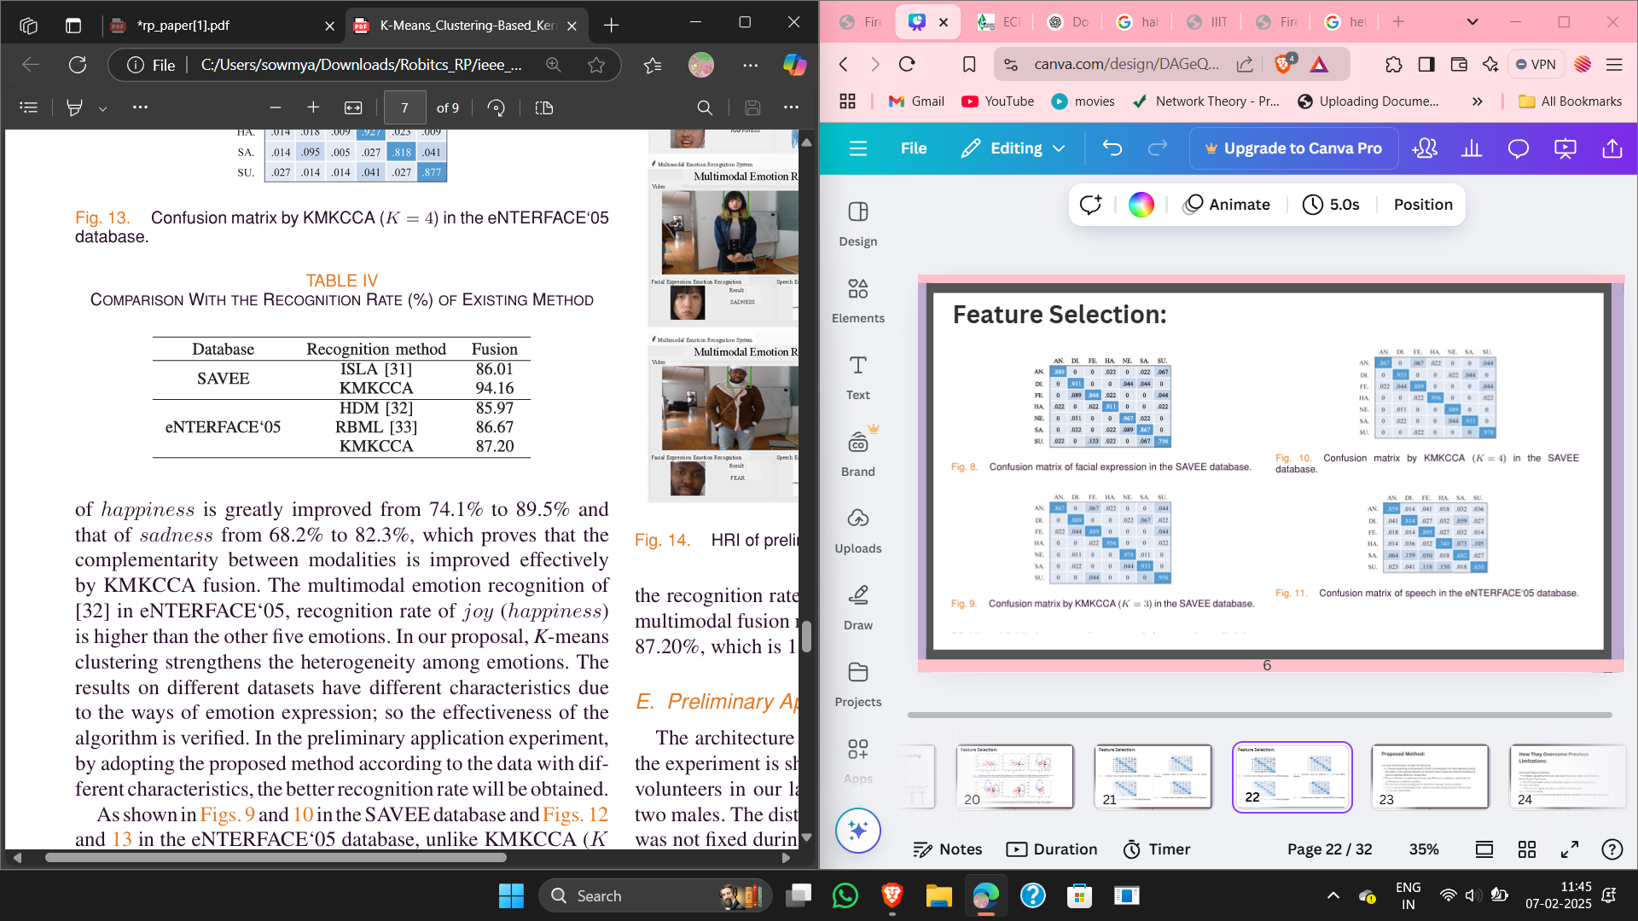
Comparision with old methods:
ISLA (Informed Segmentation and Labeling Approach) → 86.01% (SAVEE)
RBML (Rule-Based Machine Learning) → 85.97% (eNTERFACE'05)
HDM (Hybrid Deep Model) → 86.67% (eNTERFACE'05)
Our KMKCCA (K=4) method achieved the highest accuracy:
94.16% (SAVEE) → 8.15% better than ISLA.
87.20% (eNTERFACE'05) → 1.23% better than HDM​.
25

Slide 26
How They Overcame Previous Limitations:
Enhanced Feature Selection:
K-Means clustering removes redundant features, improving efficiency.
Better Fusion Technique:
KCCA finds hidden patterns between speech and facial expressions.
Stronger Classifier:
SVM ensures higher accuracy in emotion classification.
More Robust to Noise:
Kernel-based correlation techniques handle nonlinear relationships effectively.
26

Slide 27
Key Contributions of the Paper:
Introduced K-Means Clustering for feature selection before fusion.
Used Kernel CCA for better multimodal fusion.
Achieved higher accuracy on standard emotion recognition datasets.
Provided insights on kernel selection for different datasets.
Enhanced robustness of emotion recognition models in real-world applications.
27

Slide 28
Limitations of Existing Methods:
Challenges in real-time emotion recognition due to processing speed.
Individual differences in emotion expression affect accuracy.
Future work will focus on handling personalized emotion characteristics and improving multimodal feature integration for better human-robot interaction (HRI)
28

Slide 29
Overcoming the Limitations:
Apply Advanced Deep Learning: CNNs or transformers could improve feature extraction.
Improve Noise Handling: Use denoising techniques for speech and image data.
Optimize Kernel Selection: Adaptive kernel selection can further improve KCCA results.
Expand to Real-World Data: Test on larger, more diverse datasets.
By integrating deep learning, advanced feature extraction, better fusion techniques, and optimized classification models, you can significantly improve emotion recognition accuracy and real-time performance!
29

Slide 30
Conclusion:
The proposed KMKCCA algorithm effectively combines speech and facial expression features for emotion recognition.
K-means clustering improves feature selection before fusion.
Kernel CCA successfully captures nonlinear relationships between modalities.
SVM classifier provides higher recognition rates compared to previous methods.
Achieved 94.16% (SAVEE) and 87.20% (eNTERFACE’05), outperforming older models​
30

Slide 31
Thank You
31

